Slide 1
Investigating an engineered product
Unit 2
by Your name goes here
Learning Aim A: Understand the performance requirements of an engineered product
For the Learning Aim A section of coursework you need to:
Analyse an engineered product (look at it, take it apart, make judgments about it)
2. Write a technical specification for it. (write a document that communicates the basic and advanced technical requirements)
A

Slide 2
Product Analysis - BASIC
On this slide you will write the basic product analysis. You must explain your findings in as much detail as possible under each of the headings below.
The form of this product is….
The VEX kits look like……….., It evokes a feeling of………, The colours and surface design are designed to…….., The size is….., It has microcontrollers and Xbox style controllers. It is designed to appeal to…. The range of components are designed to…..
The function of this product is…
The VEX kits are designed to……, they have the function of…..,
The buttons are used for……, The controllers are used for…., The overall purpose of this product is….,
The user requirements for this product are….
The user of this product will want it to…., It must be durable because….,
You must be able to add and update software because….., The main components must be accessible because the user may need to …., It must be light and portable because…., It must look good because….., It must run stable software because…, it must be easy to use because…., the instructions supplied must be easy to understand because…., after sales support should be available because…,

Slide 3
Product Analysis - Advanced
Performance requirements – Complete and then rearrange the sentences below to make a paragraph
The performance requirements of the vex educational kits are:
The software must be stable because……,The buttons and controllers must be durable because…..,The buttons and joysticks must be replaceable because….., The cortex must be accessible because….., The motor units must be enclosed because…., The operating systems must be kept up to date because…,The USB controller interfaces must be of suitable quality because…., The mechanical parts must be safe to use because…., The lie span of the product should be…..
Material and component requirements – Sort the list below into the grid provided.
The materials and components used in production are:
Thermoplastics, thermosetting plastics, Copper wire, Printed circuit boards, Cable ties, controllers, motors, sensors, power supply, batteries, cable ties, structural parts, micro switches, wheels, cogs, split pins, nuts, bolts.
Materials | Components
Ease of manufacture
Explain the best way of manufacturing the product, describe the advantages and disadvantages of using brought in components, explain the advantage of laser cutting the plywood case, explain the easiest way to assemble the product.

Slide 4
Product Analysis – Advanced cont.
Ease of maintenance
The features of this product that make it easy to maintain are…..
They help to user maintain the product by….
Including a set of instructions will help to user maintain the product by….
Providing after sales support will help to maintain the product as….
The legal and safety requirements – Home work
Use the links below to research safety standards and then write a paragraph or more explaining what legal and/or safety standards you would need to meet when selling this product.
http://www.hse.gov.uk/work-equipment-machinery/uk-law-design-supply-products.htm#electrical-equipment-regulations
http://www.hse.gov.uk/work-equipment-machinery/standard.htm
http://www.hse.gov.uk/work-equipment-machinery/technical-file.htm
End of Learning Aim A
Grade : Pass / Merit / Dist

Slide 5
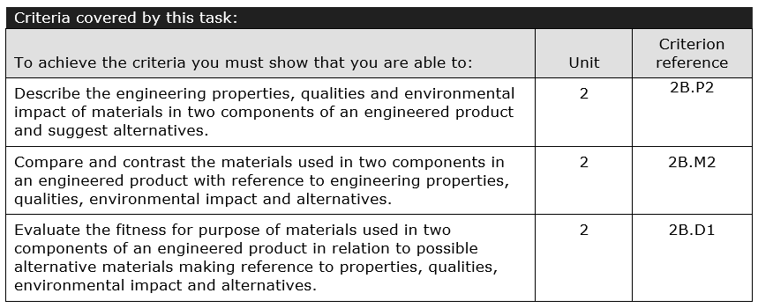
Investigating an engineered product
Unit 2
by Your name goes here
Learning Aim B: Understand the selection of specific materials for the components that make up an engineered product.
For the Learning Aim B section of coursework you need to:
Disassemble the engineered product and then produce a written report that contains.
A description of two component parts in the product
The name, properties and qualities of the materials each component is made from
Environmental impact analysis of materials used, extraction, processing and disposal
Details of alternative materials that could be used in the project
B

Slide 6
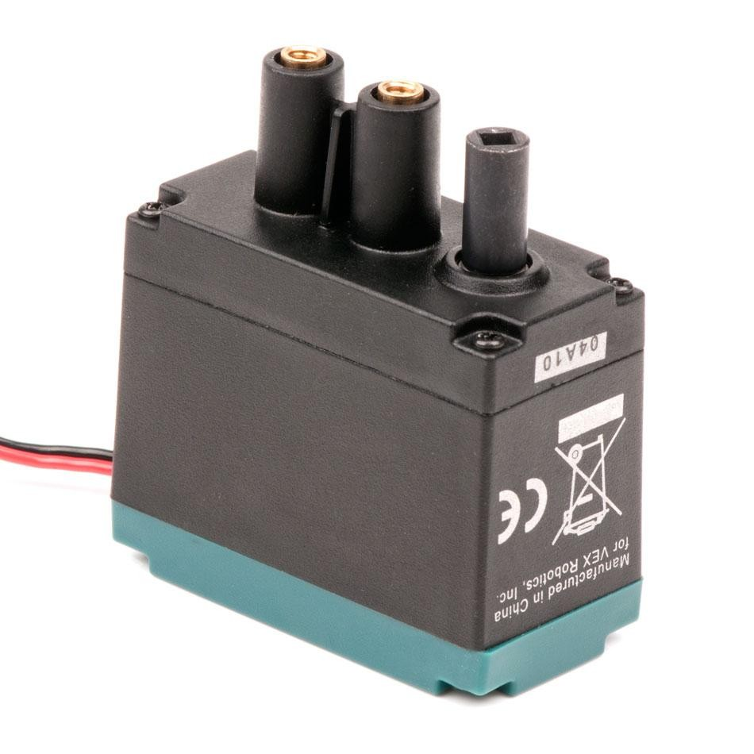
Analysis – Component 1
Use these sentence starters to help you write a description of the USB PCP component
The function of the Motor is to ………
The size of the motor is……..
The motor is fixed down by…..
Vex Motor Components | Materials | Properties / Qualities
Screws
Gears
Circuit board
Motor
Shell
Axel pins
Copper wire
Washers
Label the parts of the component

Slide 7
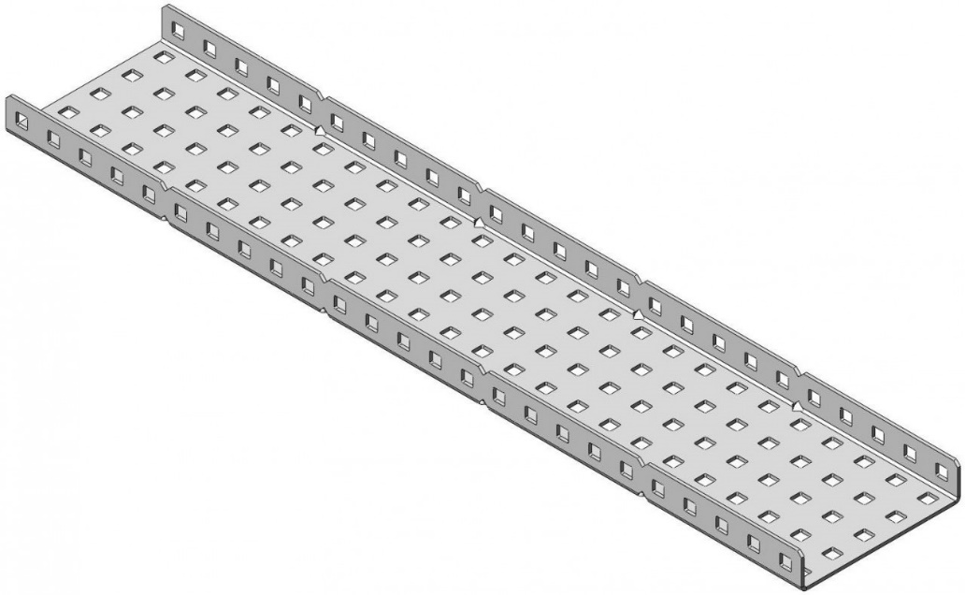
Analysis – Component 2
Use these sentence starters to help you write a description of the USB PCP component
The function of the joystick is to ………
The size of the joystick is……..
The joystick is moveable because…..
Joystick Components | Materials | Properties / Qualities
Extruded shape
Punched holes
Dividing ‘V’s’
Label the parts of the component

Slide 8
Analysis – Comparison of materials used in two components
Complete the grid below and then use these sentence starters to help you write a comparison of the USB PCP and Joystick components
Component 1 | Extraction / processing Method | Environmental impact | Alternative materials
Electrical Solder
Copper wire
Resistors
Moving parts
Electrical terminal blocks
Plastic casing
Component 2 | Extraction / processing Method | Environmental impact | Alternative materials
Extruded shape, steel
Punched holes
Dividing ‘V’s’

Slide 9
Analysis – Evaluation of materials used in two components
The materials these two components have in common are……..
The most damaging material to the environment used in the motor is…………this is because……..
The most damaging material to the environment used in the structural piece is…………this is because……..
The most renewable material used in the motor is…………this is because……..
The most renewable material used in the structural piece is…………this is because……..
The hardest material to shape is……..
Both components use plastics, metals and composite materials this is because…..
The most sustainable alternative material I have identified is … this is because….
I conclude that when I have considered the environmental impact, the material processing needs, alternative materials and sources available that the materials used in the …………………. Make it a better component than the……………. Because……………..
I suggest the following alternative materials, could be used to reduce environmental damage………
I suggest the following alternative production methods, could be used to reduce environmental damage………
End of Learning Aim B
Grade : Pass / Merit / Dist

Slide 10
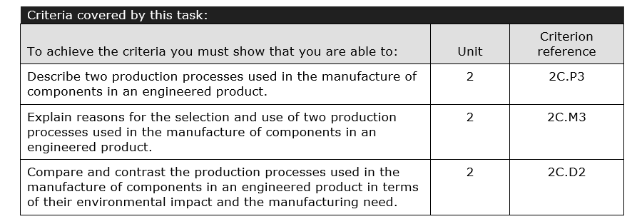
Investigating an engineered product
Unit 2
by Your name goes here
Learning Aim C: Understand the selection and use of manufacturing processes in an engineered product.
For the Learning Aim C section of coursework you need to:
Produce a written report of two or more production processes including diagrams and technical information that includes:
A description of the processes used in the manufacturing of two different components.
Justification of why these processes were used, and why they were suitable for the product.
Environmental impact analysis of processes used that includes energy, resources, waste production and pollution
A summary that evaluates the advantages and disadvantages based on the findings from earlier on in the report.
C

Slide 11
Production process analysis – Component 2
Process | Part | Description of process | Justification
Electrical soldering | Motor and parts | Electrical soldering is | This component needed the soldering process because… Soldering was suitable for this component because…
Injection moulding | Clips and retaining plate. Ball top. | Injection moulding is… | This component needed the injection moulding process because… Injection moulding was suitable for this component because …
Plasma cutting | Metal plate / Plywood carcass | Sheet metal die cutting is… | This component needed the die cutting process because… Die cutting was suitable for this component because …
Vacuum forming | Pi Case, Buttons | Vacuum forming is….. | This component needed the vacuum forming process because… Vacuum forming was suitable for this component because …
Task 1:
Select two of the four processes and use the sentence starters and your own research to complete the descriptions of each process and then justify (give clear reasons for) why each process was selected

Slide 12
Task 2:
Use diagrams and a written explanation of the Injection moulding process to explain how it works.

Slide 13
Task 3:
Use diagrams and a written explanation of the Plasma and laser cutting
process to explain how they works.

Slide 14
Environmental impact analysis of processes used
Production process | Energy Consumed | Resources needed used | Waste Products | Pollution caused
Electrical soldering | Low High 1 2 3 4 5 6 7 8 9 10 | The materials and resources needed for this process are…. | The wastes produced by this process are… | The pollutants caused are… Low High 1 2 3 4 5 6 7 8 9 10
Injection moulding | Low High 1 2 3 4 5 6 7 8 9 10 | The materials and resources needed for this process are…. | The wastes produced by this process are… | The pollutants caused are…. Low High 1 2 3 4 5 6 7 8 9 10
Plasma and laser cutting | Low High 1 2 3 4 5 6 7 8 9 10 | The materials and resources needed for this process are…. | The wastes produced by this process are… | The pollutants caused are…. Low High 1 2 3 4 5 6 7 8 9 10
Vacuum forming | Low High 1 2 3 4 5 6 7 8 9 10 | The materials and resources needed for this process are…. | The wastes produced by this process are… | The pollutants caused are…. Low High 1 2 3 4 5 6 7 8 9 10
Task 4:
1: Assess the level of energy consumed.
2: describe the resources needed for each process.
3: detail the waste products produced by using each process.
4: list the pollutants caused.

Slide 16
Analysis – Evaluation of production processes
I conclude that when I have considered the environmental impact, the material and resource needs, pollutants caused and energy consumed by…………………. And …………………….. Production processes that ……………………….. Is a more sustainable process because……………………
I suggest the following alternative materials, could be used to reduce environmental damage………
End of Learning Aim C
Grade : Pass / Merit / Dist

Slide 17
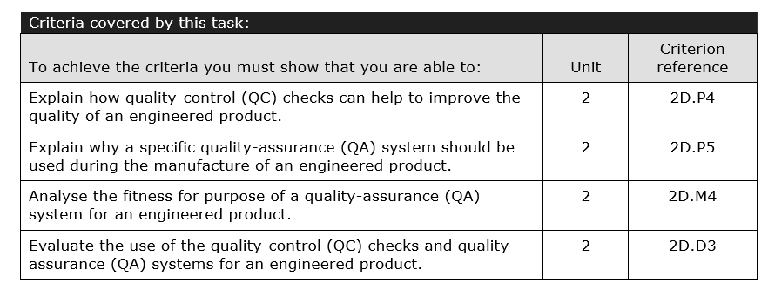
Investigating an engineered product
Unit 2
by Your name goes here
Learning aim D: Understand the quality issues related to an engineered product
For the Learning Aim D Understand the quality issues related to an engineered product
Explain how quality-control (QC) checks can help to improve the quality of an engineered product.
Explain why a specific quality-assurance (QA) system should be used during the manufacture of an engineered product.
Analyse the fitness for purpose of a quality-assurance (QA) system for an engineered product.
Evaluate the use of the quality-control (QC) checks and quality-assurance (QA) systems for an engineered product.
D

