Slide 1
Unit 31 Production Planning for Engineering
Learning aim A : - Know about scales of production and the processes and types of equipment used in manufacturing organisations.

Slide 3
Key stages of production in manufacturing organisations
Task A: Arrange the blocks below to create a block diagram that places the eight key stages in order.
Task B: Add notes to each stage to explain what it is and why it is important to the overall production process.
Pass
Fail
Pass
Fail
Quality Control
Moulding and casting
Market Research
Designing
Quality Control
Pass
Fail
Quality Control
Assembly
Separating
Finishing
Conditioning
V
Pass
Fail
Dispatch
Quality Control
Waste / Recycling
P2

Slide 4
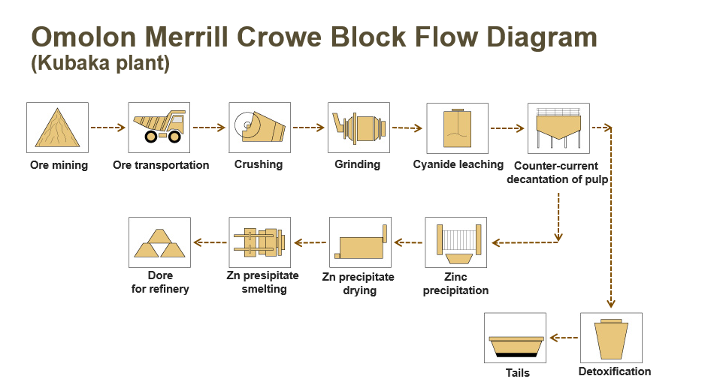
Scales of production:
Continuous production:
Task A: Research and then explain in detail the key features of continuous production
Your explanation goes here…
P1
Task B: Research and then explain in detail how machines and processes are used to create this product
Your explanation goes here…
e.g. Block diagram
M1
P3
Task C: Create a block diagram / system map of the key stages of production for this product.

Slide 5
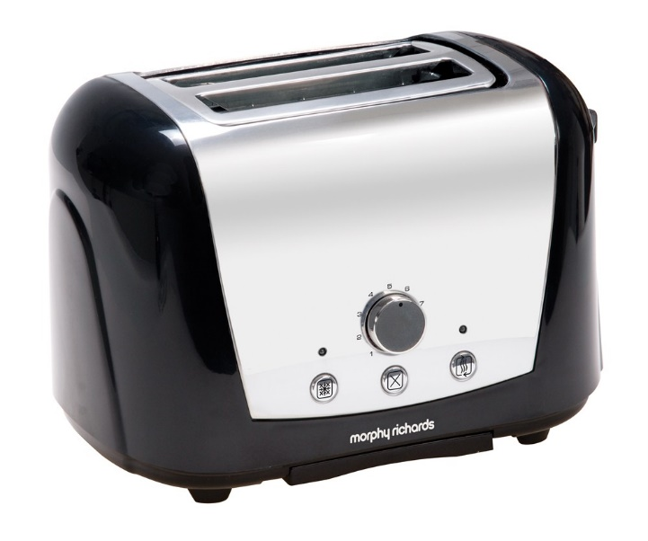
Scales of production:
Mass production:
Task A: Research and then explain in detail the key features of mass production
Your explanation goes here…
P1
Task B: Research and then explain in detail the machines and processes used to create this product
Your explanation goes here…
e.g. Block diagram
M1
P3
Task C: Create a block diagram / system map of the key stages of production for this product.

Slide 6
Scales of production:
Batch production:
Task A: Research and then explain in detail the key features of Batch production
Your explanation goes here…
P1
Task B: Research and then explain in detail the machines and processes used to create this product
Your explanation goes here…
e.g. Block diagram
M1
P3
Task C: Create a block diagram / system map of the key stages of production for this product.

Slide 7
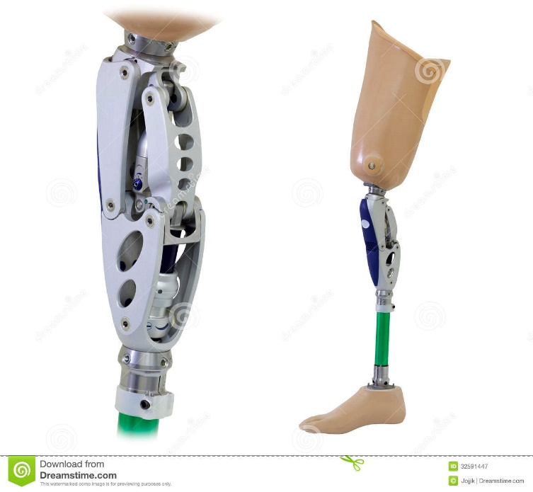
Scales of production:
One off production:
Task A: Research and then explain in detail the key features of one off production
Your explanation goes here…
P1
Task B: Research and then explain in detail the machines and processes used to create this product
Your explanation goes here…
e.g. Block diagram
M1
P3
Task C: Create a block diagram / system map of the key stages of production for this product.

Slide 8
Types of manufacturing equipment
Task A: Create an informational poster that displays examples for each type of manufacturing equipment listed below.
Task B: Explain with annotations how each type of machine relates to the four different scales of production.
Dedicated / Special
Dies
Moulds
Bespoke machinery
General Purpose
Vertical Mill
Centre Lathe
Pillar Drill
Grinders
Saws
Welding equipment
Small scale moulding
Automated
Production robots
Bespoke machinery
Control systems
Computerised
CNC Cutters / Mills
3D design applications
M2

Slide 9
Justification of production methods
Task A: Thinking about the products and production methods you explored so far write a justification for each item that explains all the reasons why the production method is most suitable. (Quantity, Ease, Material properties, production rates, machinery & tooling)
Justify why continuous manufacturing is most suitable for the arcade button.
Justification:
Justify why batch manufacturing is most suitable for the bicycle.
Justification:
Justify why mass manufacturing is most suitable for the toaster.
Justification:
Justify why batch manufacturing is most suitable for the prosthetic leg.
Justification:
D1

