Slide 1
Unit 31- LA B Production Planning for Engineering
Learning aim B : - Be able to produce a production plan and product specification and prepare related information

Slide 2
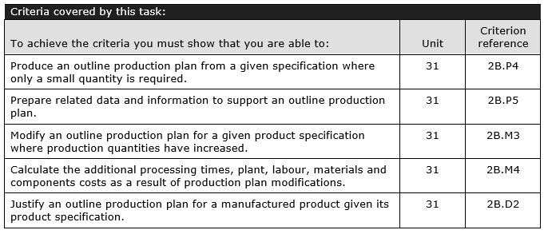

Slide 3
One off production plan
This will become your one off production plan:
Process (Describe each step you have to take to make the object) | H & S (Describe any H&S factors / consideration related to the process step) | QC (Describe what you would do at this stage to control quality) | Time taken (Record the expected time taken for this activity)
E.g. Cut round bar 20mm diameter into lengths of 70mm. | e.g. Follow risk assessment for use of hand tools and work holding. See RA at back of this document | e.g. Check measurements twice before marking and cutting, check quality of cut ends and re-measure cut pieces. | e.g. 3 minutes per cut

Slide 4
One off production plan - See example below
Cost: (Total up any material and labour costs, labour can be costed at £15 per hour)
Labour: E.g.
70 minutes = £16.25 @ £15 per hr
Materials: (Describe the total quantity of materials needed for the production)
e.g.10x70mm of 40mm diameter Nylon rod = £4.00
Plant: (Total up the running costs of any machinery or tools e.g. £1 for every use of a machine would cover keeping the machinery maintained)
E.g. 10 uses of a machine - £10
Total cost: (Total up all costs including, labour, plant, materials and where needed distribution and packaging)
e.g. £30.25

Slide 5
Small batch production
This will become your Small Batch production plan follow the same technique to fill this in as the one off plan but make sure that you adapt / change the plan to suit the different processes chosen.
Process | H & S | QC | Time taken

Slide 6
Small batch production plan
Create a costing sheet as with the example in the one off production plan but which addresses the costs and needs of the larger plan

Slide 7
Medium batch production plan
This will become your Small Batch production plan follow the same technique to fill this in as the one off plan but make sure that you adapt / change the plan to suit the different processes chosen.
Process | H & S | QC | Time taken

Slide 8
Medium batch production plan
Create a costing sheet as with the example in the one off production plan but which addresses the costs and needs of the larger plan

Slide 9
Justification – (Explain why you have chosen to use different techniques and processes for one of the production plans).
e.g.
This one off production process takes about 28 minutes to make one piece. This is quite a hands on process as the labourer needs to do a lot of work like operate the lathe themselves. You have to measure using callipers and rulers which slows down the production making it a slower process overall. The slower the production process the more time and energy that is used which will increase the price to the customer.
If a product is made as a one off then the product can be made unique and specific to the buyer. This is the most expensive production method however it is the cheapest in terms of machinery and running costs as majority of the work is done manually.
The medium batch process is slightly different to small batch as more products are made. By allowing the user to create more pieces in a quicker time, the process is more automated and less manual labour which reduces the overall cost to the buyer. The medium batch will take roughly double the time however will bring a larger yield.

Slide 10
H&S Glossary
In this section of your report you should include any risk assessments relevant to the processes undertaken.
E.g. if you identify that a CNC machine needs to be used for one of the plans then you should include links to the manual and a risk assessment for using the machine particular to the activity it is being used for.

